Slide 1
Chapter 9
Net working capital and cash flow management
Slides by Prof C Rootman,
Dr S Watson, Ms E Kobese
& Ms N Maliwa

Slide 2
Learning outcomes: Chapter 9
decide on a working capital financing policy
identify sources of short-term financing
distinguish between profitability and cash flow
efficiently manage cash
estimate optimal cash balances
compile a cash budget
prevent losses of cash by means of internal control.

Slide 3
Introduction
Can you remember the 3 main financial management decision-making areas…?
capital budgeting, capital structuring, working capital management
One of the most NB working capital management decisions: To what extent will ST debt (CL) be used to finance CA?
NWC = CA – CL
NWC generally part of CAs that is financed with LT funds
Since CL include ST financing sources, as long as CA > CL, LT funds are needed to finance the deficit…

Slide 4
Working capital financing policies
A firm’s financing requirements can be split into 2 types of needs
Permanent needs: financing needed for NC assets, and a permanent portion for the firm’s CA
Seasonal needs: financing needed for some temporary CAs during the year
WC financing policy depends on how permanent and seasonal needs are financed
Moderate/maturity-matching
Aggressive
Conservative
NB to consider textbook sections on these

Slide 5
Working capital financing policies (cont.)
Moderate/maturity-matching
Fig 9.1

Slide 6
Working capital financing policies (cont.)
Aggressive
Fig 9.2

Slide 7
Working capital financing policies (cont.)
Conservative
Fig 9.3

Slide 8
Working capital financing policies (cont.)
Distinction between approaches based on relative amount of ST financing used: conservative LOWEST whereas aggressive HIGHEST
ST debt riskier than LT debt
Interest rates on LT debt relatively stable; ST debt interest rates fluctuate, could increase to high levels
If rely too heavily on ST borrowing…may be unable to repay loans
ST financing advantages
Easier/quicker to obtain
Don’t want to commit to LT debt since flotation/issue cost higher; early re-payment with penalties…flexibility with ST debt

Slide 9
Sources of ST financing
Sources to meet financing needs of less than 1 year
Spontaneous
Unsecured loans
Secured loans
Spontaneous ST financing arises from normal operating cycle
Accounts payable (trade credit from creditors)
Accruals
Both these spontaneous: increase and decrease with sales (remember Ch 5…?)

Slide 10
Sources of ST financing (cont.)
AP
Buying goods/services and paying the creditor later
No explicit costs, only if discount is offered (part of the credit terms); see eg 9.2 on pg 190 in TB

Slide 11
Sources of ST financing (cont.)
Accruals
E.g. salaries and taxes due for payment in the near future but temporarily serve as “finance” for the firm
No interest costs is payable on funds “raised” through accruals

Slide 12
Sources of ST financing (cont.)
Unsecured
Bank loans (bank credit)
Interest rates based on prime rate, adding a premium
Interest rates on fixed loans are set at date negotiated and remain unchanged for duration
Interest: pay paid in advance or at maturity
See eg 9.3 on pg 192 in TB

Slide 13
Sources of ST financing (cont.)
See eg 9.4 on pg 192 in TB

Slide 14
Sources of ST financing (cont.)
Secured
Pledging specific assets as collateral
Accounts receivable (debtors) and inventory preferred sources of collateral due to liquidity
We will only look at some! (AR, not at inv in 3rd year)
E.g. factoring AR: selling AR at a discount to a financial institution
Cash is received for outstanding AR immediately
Reduces amount of WC required
Credit and collection actions and expenses now done by the factor

Slide 15
Sources of ST financing (cont.)
See eg 9.8 on pg 197 in TB

Slide 16
Management of cash
Aim for a positive margin between cash inflows and cash outflows
Liquidity refers to adequacy of cash available to meet obligations of firm timeously and to continue operations
CF measures liquidity
NB: profitability ≠ CF
Profitability measures performance, fin situation and use to determine taxes
CF recognises income and expenses only wrt ACTUAL inflow and outflow of cash
Look at E.g. 9.9 on pg 199 of TB to see a firm could be profitable but in financial failure due to poor actual CF

Slide 17
Cash and near-cash
Cash
“Ready” money in current account or petty cash available for immediate use
Near cash
E.g. AR, marketable securities (most liquid of these) and unit trust investments
Motives for holding cash
Transactions
Compensating balances
Speculative
Precautionary

Slide 18
Cost of cash
Opportunity cost of foregoing other investment opportunities
Excessive reliance on internally generated liquidity may make it difficult to obtain ST financing
Cash could have been used to offset cost and fin risk from ST debt
Can’t have too much cash on hand BUT…can’t have too little cash on hand…

Slide 19
Cost of cash (cont.)
Consider the cash conversion cycle to ensure efficient management of cash (covers TB pgs 202 – 205)
(Do NOT cover TB pgs 206 – 209)

Slide 20
Cost of cash (cont.) – efficient mngt of cash
Operating activities create unsynchronised patterns of cash inflows and outflows (influencing firm’s WC management)
Cash payment for raw materials does not happen at exactly the same time as receipt of cash from sale of the product
CFs furthermore uncertain (future sales and costs can’t be precisely predicted)
Hence need to plan ahead wrt cash balances…since it influence all investment and financing decisions

Slide 21
Cost of cash (cont.) – efficient mngt of cash
Operating activities create unsynchronised patterns of cash inflows and outflows (influencing firm’s WC management)
Cash payment for raw materials does not happen at exactly the same time as receipt of cash from sale of the product
CFs furthermore uncertain (future sales and costs can’t be precisely predicted)
Hence need to plan ahead wrt cash balances…since it influence all investment and financing decisions

Slide 22
Cost of cash (cont.) – efficient mngt of cash
E.g. Today (Day 0) you purchase R1 000 worth of inventory on credit
You only pay the account 30 days later
After another 30 days (i.e. on Day 60) you sell inventory for R1 400 on credit
Your buyer (debtor) only pays after 45 days from date of sale
Day | Activity | Cash effect
0 | Acquire inventory | None
30 | Pay inventory | -R1 000
60 | Sell inventory on credit | None
105 | Collect payment on sale | +R1 400

Slide 23
Cost of cash (cont.) – efficient mngt of cash
Let’s take a closer look …
Average age of inventory (AAI) or Inventory conversion period (ICP)
Time period between acquisition of inventory and sale of inventory (60 days)
Inventory purchased
Inventory sold
AAI
DSO
60 days
45 days
Accounts payable
Cash cycle
30 days
60 + 45 – 30 = 75 days
Cash paid for inventory
Cash received

Slide 24
Cost of cash (cont.) – efficient mngt of cash
Average collection period (ACP)
Time period between sale of inventory and collection of receivables (cash form sale) (45 days)
Also called accounts receivables period or Days sales outstanding (DSO)
Inventory purchased
Inventory sold
AAI
ACP
60 days
45 days
Accounts payable
Cash cycle
30 days
60 + 45 – 30 = 75 days
Cash paid for inventory
Cash received

Slide 25
Cost of cash (cont.) – efficient mngt of cash
Average payment period (APP)
Time period between receipt of inventory and payment for it (30 days)
Also called accounts payables/deferral period or Days payables outstanding (DPO)
Inventory purchased
Inventory sold
AAI
ACP
60 days
45 days
APP
Cash cycle
30 days
60 + 45 – 30 = 75 days
Cash paid for inventory
Cash received

Slide 26
Cost of cash (cont.) – efficient mngt of cash
Spend cash on Day 30 … only receive cash on Day 105 …☹
Cash cycle
Time period between cash disbursement (payment/ outflow) and cash collection (inflow) (75 days)
Inventory purchased
Inventory sold
AAI
ACP
60 days
45 days
APP
Cash conversion cycle
period 30 days
60 + 45 – 30 = 75 days
Cash paid for inventory
Cash received

Slide 27
Cost of cash (cont.) – efficient mngt of cash
Cash conversion cycle (CCC) = Average age of inventory + Average collection period – Average payment period
= AAI + ACP – APP
= 105 days – 30 days
= 75 days
Cash “gap” or shortage can be financed by means of ST borrowing or using liquidity reserves such as marketable securities (money market funds)

Slide 28
Cost of cash (cont.) – efficient mngt of cash
Average age of inventory (AAI)
= 360 / Inventory turnover
= 360 / (Cost of goods sold / Inventory)
Average collection period (ACP)
= 360 / Receivables turnover
= 360 / (Credit sales / Receivables)

Slide 29
Cost of cash (cont.) – efficient mngt of cash
Average payment period (APP)
= 360 / Payables turnover
= 360 / (Credit purchases / Accounts payable)
[if purchases not given: use cost of goods sold (COS)]
Cash conversion cycle (CCC)
= AAI + ACP – APP

Slide 30
Cost of cash (cont.) – efficient mngt of cash
Gap can be shortened by:
Decreasing AAI (transforming raw materials into final products quicker)
Decreasing ACP (collecting money from AR/debtors sooner…HOW?)
Increasing APP (taking longer to pay AP/creditors/suppliers…HOW?)

Slide 31
Cost of cash (cont.) – efficient mngt of cash
Example:
Cash conversion cycle (CCC) 2025 = AAI + ACP – APP
= 91 days + 28 days – 94 days
= 25 days
Source: https://thevault.exchange/?get_group_doc=6262/1751029031-FinalFY2025IAR.pdf

Slide 32
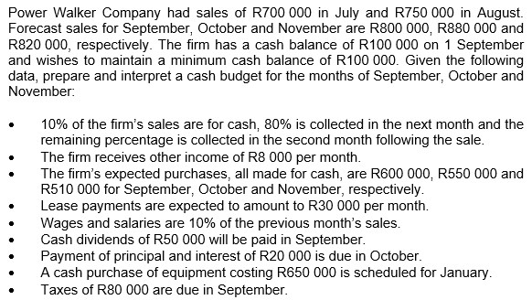
Cash planning
Rest of chapter: focus only on what the cash budget entails and how to set it up
Let’s look at it with an example

Slide 33
Cash planning (cont.)
Calculate cash receipts first
 | Sept |  | Oct |  | Nov
10% Sept | 80 000 | 10% Oct | 88 000 | 10% Nov | 82 000
80% Aug | 600 000 | 80% Sept | 640 000 | 80% Oct | 704 000
10% Jul | 70 000 | 10% Aug | 75 000 | 10% Sept | 80 000
TOTAL | 750 000 |  | 803 000 |  | 866 000

Slide 34
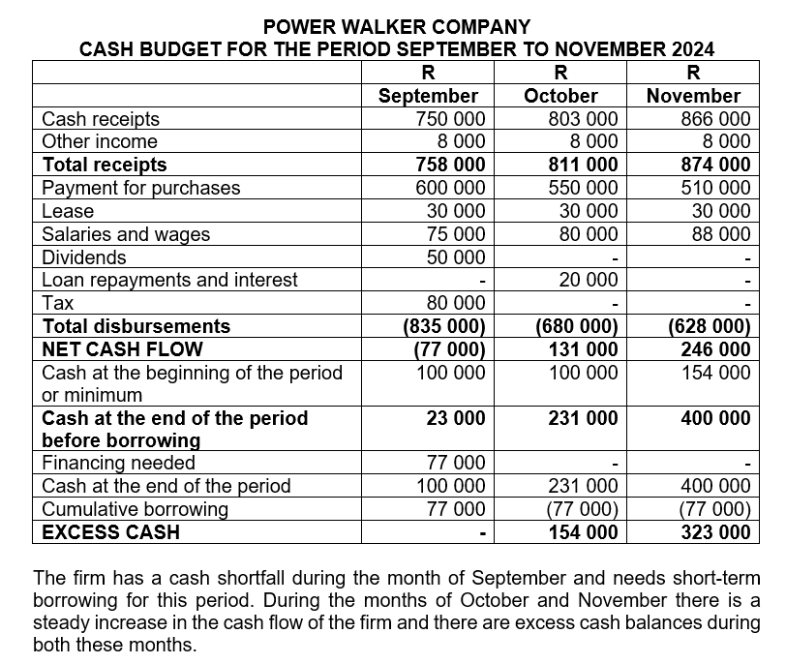
Cash planning (cont.)

Slide 35
Preparation for next session
Work through Chapter 9
Questions in study guide
Problems at the end of the chapter
Read through Chapter 10 and download/print the slides

